Slide 1

TERM PROJECT GROUP 3
MICHAEL BRUMWELL
MARCO RODRIGUEZ CHRISTOPHER ALIPIO
ARTURO MEDINA

Slide 2
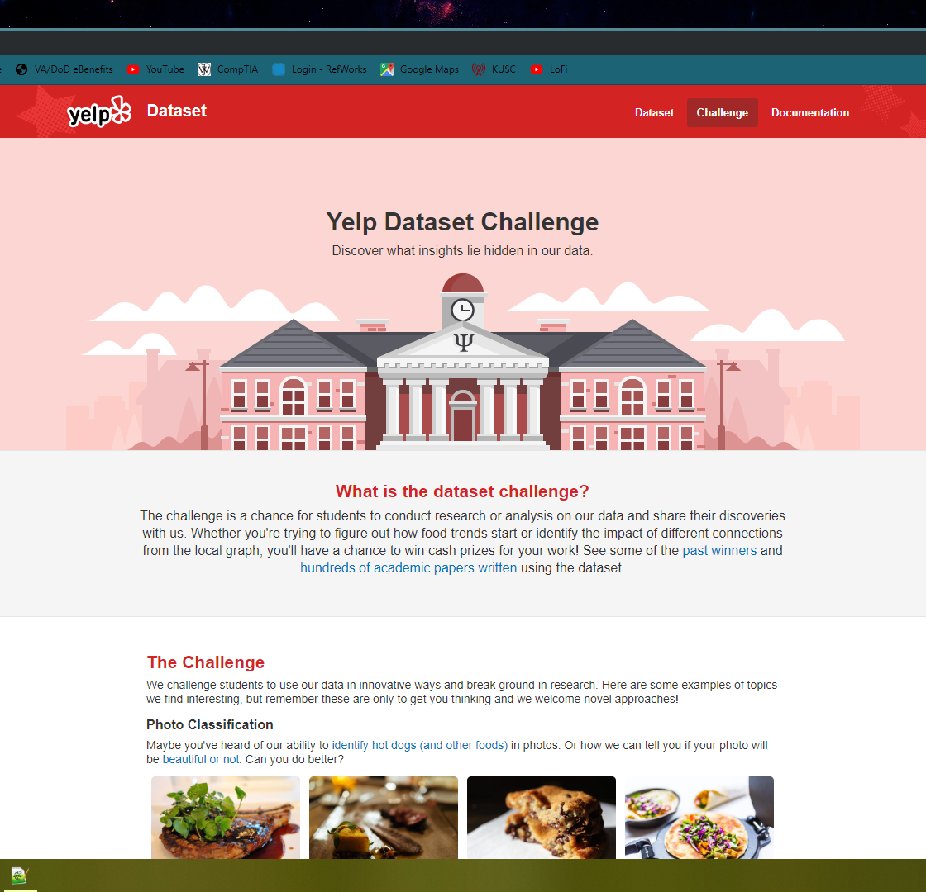
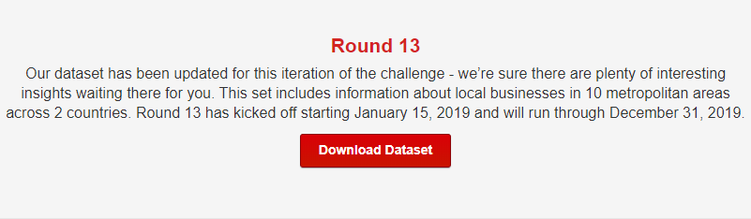
DATASET LOCATION
https://www.yelp.com/dataset/challenge

Slide 3
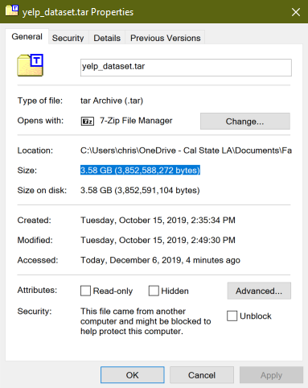
DATASET SIZE
3.58 GB

Slide 4
EXPERIMENTAL SPECIFICATIONS
EMR cluster with 3 nodes: m3.xlarge
Release label:emr-5.27.0
Hadoop distribution:Amazon 2.8.5
Applications:Hive 2.3.5, Pig 0.17.0, Hue 4.4.0, Ganglia 3.7.2, Tez 0.9.2, Sqoop 1.4.7, HCatalog 2.3.5
Tableau: Professional Edition (20192.19.1110.1721) – 64 Bit

Slide 5
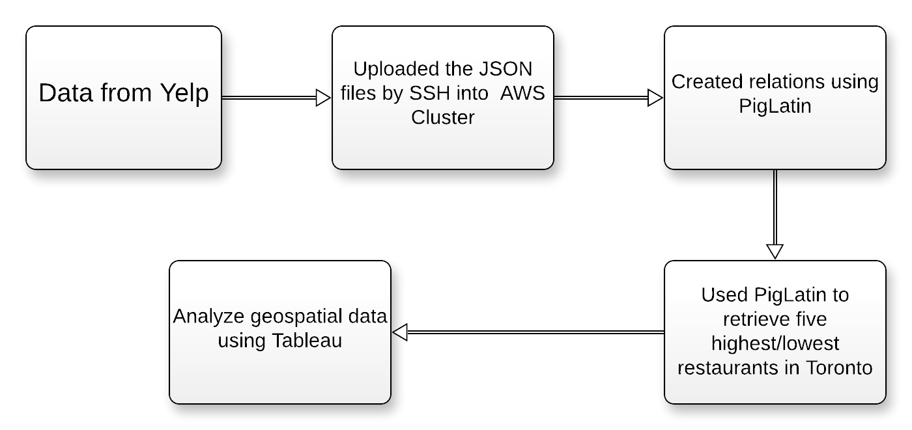
FLOWCHART FOR DATA ANALYSIS

Slide 6
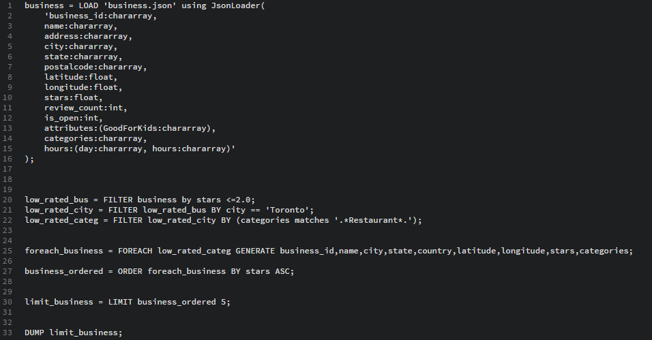
DETERMINING THE TOP 5 RATED RESTAURANTS

Slide 7
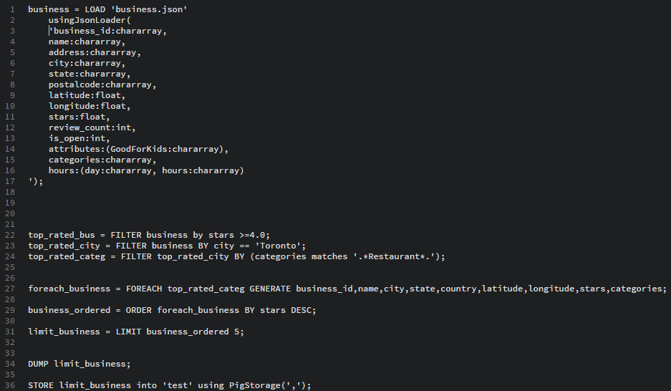
DETERMINING THE 5 LOWEST RATED RESTAURANTS

Slide 8
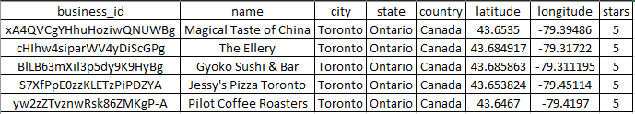
TOP 5 RESTAURANTS (TORONTO, CANADA)

Slide 9
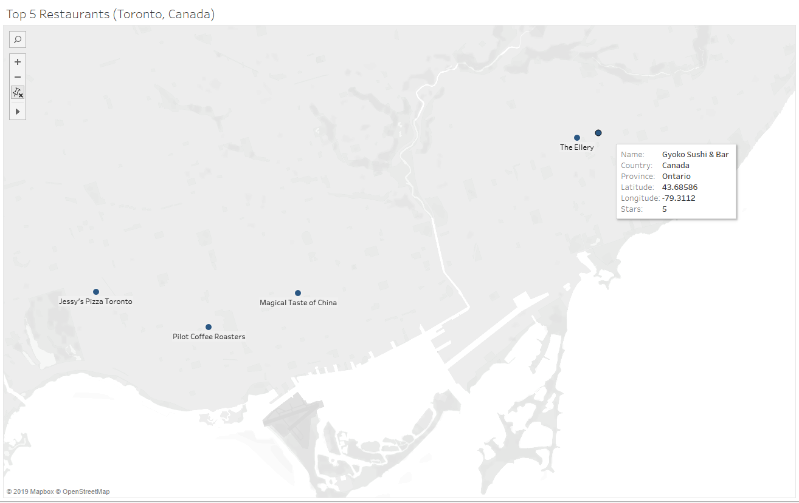
5 HIGHEST RATED RESTAURANTS (Toronto, Canada)

Slide 10
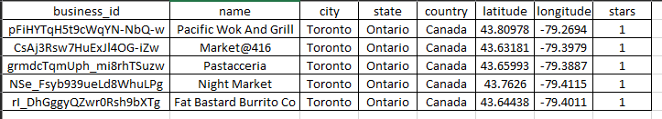
LOWEST 5 RESTAURANTS (TORONTO, CANADA)

Slide 11
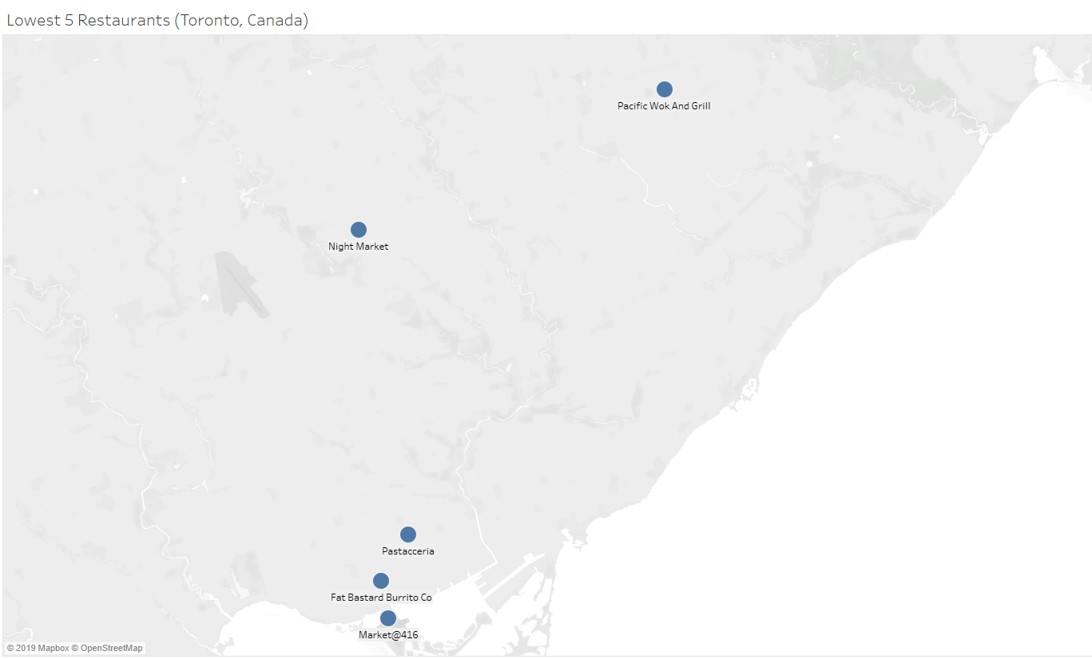
5 LOWEST RATED RESTAURANTS (Toronto, Canada)

Slide 12
REFERENCES
https://www.yelp.com/dataset/challenge

